Slide 1

React Component life cycle
Lesson 06
Notes:
Add instructor notes here.

Slide 2
Lesson Objectives
At the end of this module you will
be able to:
Explain and demonstrate
Updating life cycle hooks
Pure Components
React’s DOM Updating Strategy
Returning adjacent elements
Fragments
Notes:
Add instructor notes here.

Slide 3
Component Life Cycle
The Component Life Cycle is available only in Class Based Components.
There are some list of life cycle methods available when we add to any Class based Components.
And React will execute them for us and those methods will run at different point of time.
We can do multiple things with them when we add those methods in class- based components.
For example: When we want to fetch data from web or if we want to do some clean up work before a components are removed from DOM etc.,
Notes:
The Component Life Cycle is available only in Class Based Components.
There are some list of life cycle methods available when we add to any Class based Components.
And React will execute them for us and those methods will run at different point of time.
We can do multiple things with them when we add those methods in class- based components.
For example: When we want to fetch data from web or if we want to do some clean up work before a components are removed from DOM etc.,

Slide 4
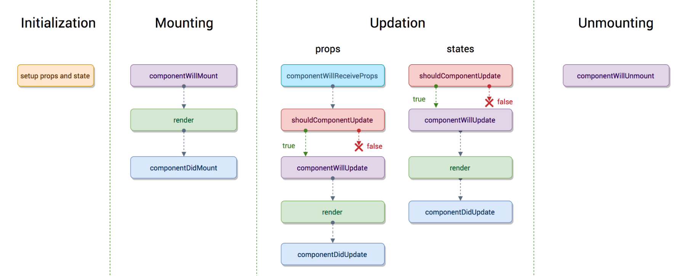
React Component - Life Cycle Phases
Changes undergone by a component from its creation till its termination.
There are main three phases of a React component
Mounting
Update
Unmounting
Notes:
The invocation of getDefaultProps actually takes place once before any instance of the component is created and the return value is shared among all instances of the component
Add instructor notes here.

Slide 5
Mounting Phase
These methods are called in the following order when an instance of a component is being created and inserted into the DOM:
constructor()
static getDerivedStateFromProps()
render()
componentDidMount()
Notes:
Mounting is the phase in which our React component mounts on the DOM (i.e., is created and inserted into the DOM).
This method is called just before a component mounts on the DOM or the render method is called.
After this method, the component gets mounted.
This phase comes onto the scene after the initialization phase is completed.
In this phase, our component renders the first time

Slide 6
Updating Phase
An update can be caused by changes to props or state. These methods are called in the following order when a component is
being re-rendered:
static getDerivedStateFromProps()
shouldComponentUpdate()
render()
getSnapshotBeforeUpdate()
componentDidUpdate()
Notes:
This is the third phase through which our component passes.
After the mounting phase where the component has been created, the update phase comes into the scene.
This is where component’s state changes and hence, re-rendering takes place.
In this phase, the data of the component (state & props) updates in response to user events like clicking, typing and so on.
This results in the re-rendering of the component.

Slide 7
Unmounting Phase
This method is called when a component is being removed from the DOM:
componentWillUnmount()
Notes:
This is the last phase in the component’s lifecycle.
As the name clearly suggests, the component gets unmounted from the DOM in this phase.

Slide 8
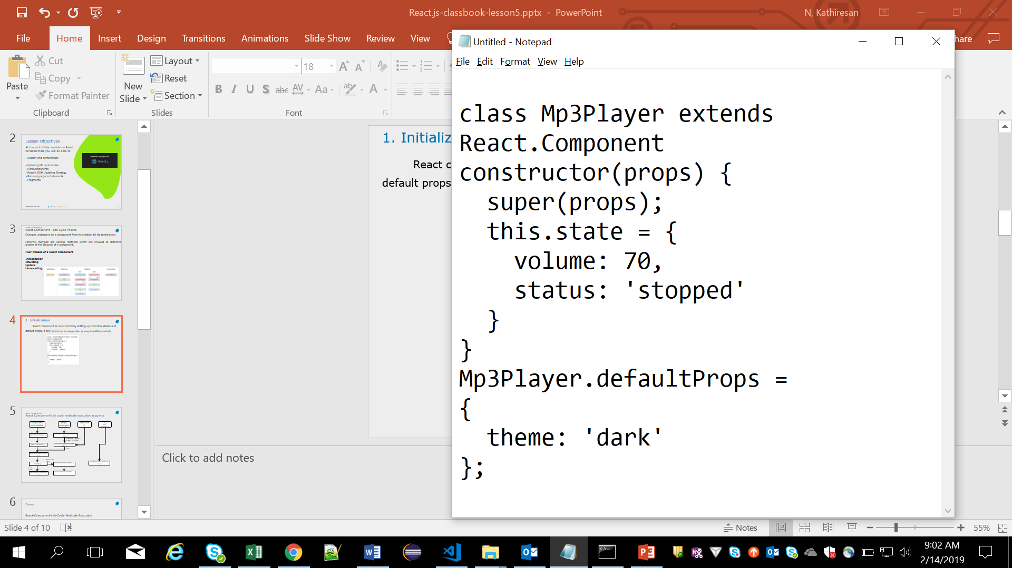
Initialization
React component is constructed by setting up the initial states and default props, if any.
State can be changed later by using setState() method.
Notes:
This is the phase in which the component is going to start its journey by setting up the state and the props.
This is usually done inside the constructor method
Till now we have seen is “what to render” and uses the render() method for this purpose.
However this method render() method alone is not enough for our requirements.
Take in case if we want to do something before or after the component has rendered or mounted ?
What if we want to avoid a re-render?
Basically all the React component’s lifecyle methods can be split in four phases: initialization, mounting, updating and unmounting.
Below is used for creating a class by React’s createClass.
Initialization
The initialization phase is where we define defaults and initial values for this.props and this.state by implementing getDefaultProps() and getInitialState() respectively.
The getDefaultProps() method is called once and cached — shared across instances.
The getInitialState() method is also invoked once, right before the mounting phase. The return value of this method will be used as initial value of this.state and should be an object.
var Component = React.createClass({
getDefaultProps: function() {
console.log('getDefaultProps');
return {
title: "Basic counter!!!",
step: 1
}
},
getInitialState: function() {
console.log('getInitialState');
return {
count: (this.props.initialCount || 0)
};
},
}

Slide 9
Mounting
Mounting is the process that occurs when a component is being inserted into the DOM.
constructor(props)
If you don’t initialize state and you don’t bind methods, you don’t need to implement a constructor for your React component.
The constructor for a React component is called before it is mounted.
When implementing the constructor for a React.Component subclass, you should call super(props) before any other statement.
Otherwise, this.props will be undefined in the constructor, which can lead to bugs.
Notes:
ComponentWillMount:
This method is used for initializing the states or props
Note : It’s very important to note that calling this.setState() within this method(componentWillMount) will not trigger a re-render.
Using React’s createClass:
getInitialState: function() {...},componentWillMount: function() { console.log('componentWillMount'); },
componentDidMount:
The API calls should be made in componentDidMount method always.

Slide 10
constructor()
In React, constructors are used only for 2 purposes :
Initializing local state by assigning an object to this.state.
Binding event handler methods to an instance.
constructor(props) {
super(props);
// Don't call this.setState() inside constructor
this.state = { counter: 0 };
this.handleClick = this.handleClick.bind(this);
}

Slide 11
constructor()
If your component need to use local state, assign the initial state to this.state inside the constructor.
You should not call setState() method inside the constructor.
“this.state” can be directly used only inside the constructor.
In all other places, you need to use setState() method.
Avoid copying the props into the state as given below:
you can use this.props.color
directly instead
constructor(props) {
super(props);
// Don't do this!
this.state = { color: props.color };
}

Slide 12
static getDerivedStateFromProps(props, state) method
This method is called right before rendering the element(s) in the DOM.
Based on initial props, this is the natural place to set the state object.
This is the static method. And so, it should return an object to update the state, or null to update nothing.
It takes state as an argument and returns an object with changes to the state.
This method exists for rare use cases where the state depends on changes in props over time.
This method doesn’t have access to the component instance.
This method is fired on every render, regardless of the cause.

Slide 13
render() method
The render() method is the only required method in a class component.
This is the method that actually outputs the HTML to the DOM.
It should be pure, meaning that it does not modify component state, it returns the same result each time it’s invoked, and it does not directly interact with the browser.
Remember that render() will not be invoked if shouldComponentUpdate() returns false.

Slide 14
Example for render ()
class Header extends React.Component {
render( ) {
return (
<h1>This is the content of the Header component</h1>
); }
}
ReactDOM.render(<Header />, document.getElementById('root'));
<html>
<head>
<title>React App</title>
</head>
<body>
<div id="root"></div>
</body>
</html>
Index.js :
index.html :

Slide 15
componentDidmount()
It is invoked immediately after a component is mounted (inserted into the tree).
Initialization that requires DOM nodes should go here.
If you need to load data from a remote endpoint, this is a good place to instantiate the network request.
When you want to set any subscriptions, you can use this method. componentWillUnmount() is the method to unsubscribe.
Notes:
ComponentWillMount:
This method is used for initializing the states or props
Note : It’s very important to note that calling this.setState() within this method(componentWillMount) will not trigger a re-render.
Using React’s createClass:
getInitialState: function() {...},componentWillMount: function() { console.log('componentWillMount'); },
componentDidMount:
The API calls should be made in componentDidMount method always.

Slide 16
componentDidmount()
You may call setState() immediately in componentDidMount().
Before the browser update the screen, it will trigger an extra rendering.
User won’t see the intermediate state even when the render() method is called twice.
Sometimes it may cause performance issue, and so use this with caution.
Notes:
You may call setState() immediately in componentDidMount().
Before the browser update the screen, it will trigger an extra rendering.
User won’t see the intermediate state even when the render() method is called twice.
Sometimes it may cause performance issue, and so use this with caution.

Slide 17
Updating Phase
The next phase in the lifecycle is when a component is updated.
A component is updated whenever there is a change in the component's state or props.
When a component is updated, React has 5 built in methods that gets called.
static getDerivedStateFromProps()
shouldComponentUpdate()
render()
getSnapshotBeforeUpdate()
componentDidUpdate()
Notes:
The list of methods that will get called when the parent sends new props are as follows:
componentWillReceiveProps gets executed when the props have changed and is not first render.
Sometimes state depends on the props, hence whenever props changes the state should also be synced.
This is the method where it should be done.
Usage: This is how the state can be kept synced with the new props.

Slide 18
shouldComponentUpdate()
This method has two arguments such as
shouldComponentUpdate(nextProps, nextState)
If you want to let React know if a component’s output is not affected by the current change in state or props, then use this method.
The default behavior of this method is to re-render on every state change.
shouldComponentUpdate() is invoked before rendering when new props or state are being received.
During initial render this method is not called.
The return type of this method is Boolean and default value is true.
This method only exist as a Performance Optimization.
Notes:
The list of methods that will get called when the parent sends new props are as follows:
componentWillReceiveProps gets executed when the props have changed and is not first render.
Sometimes state depends on the props, hence whenever props changes the state should also be synced.
This is the method where it should be done.
Usage: This is how the state can be kept synced with the new props.

Slide 19
getSnapShotBeforeUpdate() method
This method takes 2 arguments such as
getSnapShotBeforeUpdate(prevProps, prevState)
This method is invoked right before the most recently rendered output is committed to e.g. the DOM.
By this method you have access to the props and state before the update, i.e, even after update, you can check what the values were before the update.
Any value returned by this lifecycle will be passed as a parameter to componentDidUpdate().
Either a Snapshot value or null should be returned from this method.
For e.g: When we are adding new items to the list, we can capture the scroll position so that we can adjust the scroll later.

Slide 20
componentDidUpdate()
This method takes 3 arguments as given below:
componentDidUpdate(prevProps, prevState, snapshot)
This method will not be called during initial render, it will be invoked immediately after updating occurs.
If your component implements the getSnapshotBeforeUpdate() lifecycle, the value it returns will be passed as a third “snapshot” parameter to componentDidUpdate().
Otherwise this parameter will be undefined. componentDidUpdate() will not be invoked if shouldComponentUpdate() returns false.
componentDidUpdate(prevProps) {
// Typical usage (don't forget to compare props):
if (this.props.userID !== prevProps.userID) {
this.fetchData(this.props.userID);
} }

Slide 21
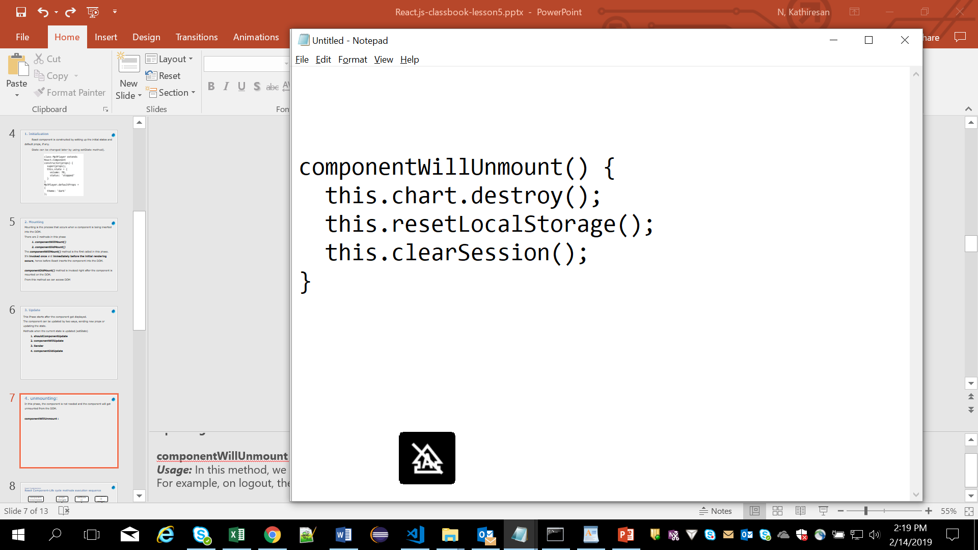
unmounting
In this phase, the method componentWillUnmount() will be invoked immediately before a component is unmounted and destroyed.
Perform any necessary cleanup in this method, such as invalidating timers, canceling network requests, or cleaning up any subscriptions that were created in componentDidMount() method.
Do not invoke setState() method because component will never be re-rendered.
Once component instance is unmounted, it will never be mounted again.
Notes:
Updating:
componentWillUnmount This method is the last method in the lifecycle. This is executed just before the component gets removed from the DOM. Usage: In this method, we do all the cleanups related to the component. For example, on logout, the user details and all the auth tokens can be cleared before unmounting the main component.

Slide 22
Legacy Lifecycle Methods
List of methods are considered legacy and you should avoid them in new code.
The lifecycle methods below are marked as “legacy”. They still work, but we don’t recommend using them in the new code.
UNSAFE_componentWillMount()
UNSAFE_componentWillUpdate()
UNSAFE_componentWillReceiveProps()

Slide 23
React Component-Life cycle methods execution sequence
component instantiated
props changed
setState ()
component deleted
getDefaultProps( )
componentWillReceiveProps ( )
setState( ) doesn’t trigger re-render
getInitialState( )
shouldComponentUpdate ( )
True
componentWillMount ( )
After First time
render ( )
componentWillUpdate ( )
componentWillUnmount ( )
First time
componentDidMount ( )
componentDidUpdate ( )
Notes:
getInitialState : The object returned by this method sets the initial value of this.state
getDefaultProps: The object returned by this method sets the initial value of this.props. If a complex object is returned, it is shared among all component instances.
componentWillMount : Invoked once immediately before the initial rendering occurs. Calling setState here does not cause a re-render.
render: Returns the jsx markup for a component. Inspects this.state and this.props create the markup. Should never update this.state or this.props
componentDidMount : Invoked once immediately after the initial rendering occurs. We have access the access to get the DOM node using ReactDOM.findDOMNode().
componentWillReceiveProps : Invoked whenever there is a prop change called before render. Not called for the initial render. Previous props can be accessed by this.props. calling setState here does not trigger an additional re-render.
shouldComponentUpdate : Determines if the render method should run in the subsequent step . Called before a render. Not called for the initial render. If the render method to execute in the next step return true, else return false.
componentWillUpdate : Called immediately before a render. this.setState() cannot be used in this method.
componentDidUpdate : Called immediately after a render.
componentWillUnmount : Called immediately before a component is unmounted.
Add instructor notes here.

Slide 24
Pure Components
React.Component life cycle hook has shouldComponentUpdate method which is set to always return true. This may be good but React might trigger unnecessary re-renders.
One way to deal with these extra re-renders is to change the shouldComponentUpdate function to check when your component needs to update.
Another way to stop extra re-renders is to use a PureComponent.
React.PureComponent is similar to React.Component.
The difference between them is that React.Component doesn’t implement shouldComponentUpdate(), but React.PureComponent implements it with a shallow prop and state comparison.
import React, {PureComponent} from ‘react’;
class Demo extends PureComponent{
render( ){
return ‘’;
} }
Notes:
When to use Pure Components?
Suppose you creating a dictionary page in which you display the meaning of all the English words starting with A. Now you can write a component which takes a word and its meaning as props and return a proper view. And suppose you using pagination to display only 10 words at a time and on scroll asking for another 10 words and updating the state of the parent component. Pure Components should be used in this case as it will avoid rendering of all the words which rendered in previous API request.
Also in cases where you want to use lifecycle methods of Component then we have to use Pure Components as stateless components don't have lifecycle methods.
NOTE : above is from medium.com website
Note
React.PureComponent’s shouldComponentUpdate() only shallowly compares the objects. If these contain complex data structures, it may produce false-negatives for deeper differences. Only extend PureComponent when you expect to have simple props and state, or use forceUpdate() when you know deep data structures have changed. Or, consider using immutable objects to facilitate fast comparisons of nested data.
Furthermore, React.PureComponent’s shouldComponentUpdate() skips prop updates for the whole component subtree. Make sure all the children components are also “pure”.

Slide 25
PureComponent which does the comparison of state and props to decide the update cycle.
We don’t need to override shouldComponentUpdate if we extend class with PureComponent.
React does the shallow comparisons of current state and props with new props and state to decide whether to continue with next update cycle or not.
React.PureComponent’s shouldComponentUpdate() only shallowly compares the objects.
You can use React.PureComponent for a performance boost in some cases.
Only extend PureComponent when you expect to have simple props and state.

Slide 26
Demo
React-Component-Life-Cycle-Methods-Execution
react-create-componentlifecycle
React-pure_component
Notes:
Add instructor notes here.

Slide 27
REACT’s DOM Updating Strategy
When render() method is invoked, it doesn’t immediately render to real DOM.
In React every UI piece is a component, and each component has a state.
Whenever there is a change in state, react determines it.
When component’s state changes, React will update the virtual DOM Tree.
So, now React will compare the current version of Virtual DOM with previous virtual DOM. This is known as “Diffing”.
So, React will update only those updated Objects in real DOM, not the whole real DOM.
This behavior of making change only in respective changed Objects will cause high performance.

Slide 28
shouldComponent Update() passed
render() called
Render will not immediately update Real DOM
Fast than Real DOM
Old Virtual DOM
Re-rendered Virtual DOM
<div>…</div>
<div>…</div>
Comparison
NO
YES
Update Real DOM (only where changes detected)
No changes in real DOM
Difference found?

Slide 29
Returning adjacent elements
Until React 16 it was required that a render method returns a single React element. With React 16 it is possible now to return an Array of elements.
Below(refer code 1 in note section) you can see an app rendering a list of Employee Assets. In React 16, it's now possible to extend this list with a component containing multiple new entries.
Generally when we render elements , we cannot render them as separate elements, we will get an error stating ‘Parsing error: Adjacent JSX elements must be wrapped in an enclosing tag’ .We have to wrap them
Using a div or li tag or we have to make use of React.Fragments. [refer code 2 in note section]
Notes:
Code 1:
class App extends Component{
render(){
return (
<div>
<li key="1">arun</li>
<li key="2">ragul</li>
</div>
);
}
}
CODE 2:
return (
<div>
<h1>hi</h1>
</div>
<div>
<li key="1">arun</li>
<li key="2">ragul</li>
</div>
Both div should have been kept in another div,

Slide 30
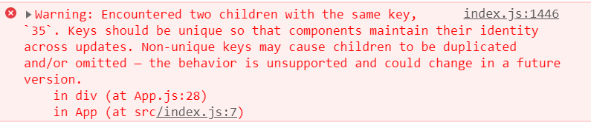
Returning adjacent elements contd.
Another important thing is we cannot render array of elements also,
If we have an array of data and on rendering them, we have to ensure that they have unique keys to separate them from other elements else we will get the below error.[refer code 3 in note section]
You will find in note section that, key is added which must be unique for each elements to get rendered as array of elements.
Notes:
Code 3:
In the below code 2 id has 35 as its value which will create duplicate keys warning while rendering
let shoppingCart = [
{id: 35, item: 'jumper', color: 'red', size: 'medium', price: 20},
{id: 35, item: 'shirt', color: 'blue', size: 'medium', price: 15},
{id: 71, item: 'socks', color: 'black', size: 'all', price: 5},
]
class App extends Component{
render(){
const items = shoppingCart.map((item, key) =>
<li key={item.id}>{item.name}</li>
);
return ( <div><h1>hi</h1></div>);
}
}

Slide 31
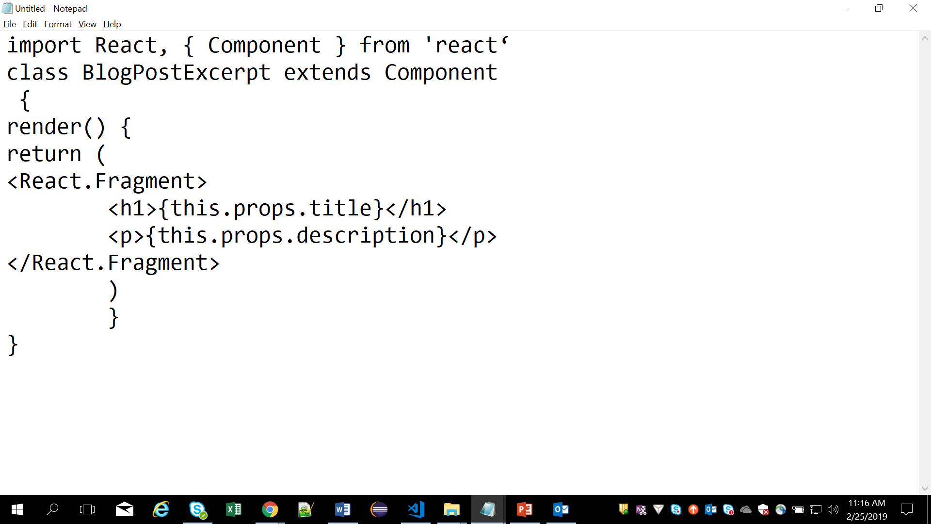
React Fragments
React@16.2 introduces the Fragment component. Until React@16 a component could only return a single element.
If returning more than one and then we can see a message like “Adjacent JSX elements must be wrapped in an enclosing tag”.
If in case need more than one, then it should be wrapped with another container tag.(say a ul or span or div etc,. or array or Fragments ).
Notes:
React@16.2 introduces the Fragment component.
we can either import the Fragment component by using belwo statement,
import React, { Component, Fragment } from 'react‘
Or
use it through the React object directly with React.Fragment
Add instructor notes here.

Slide 32
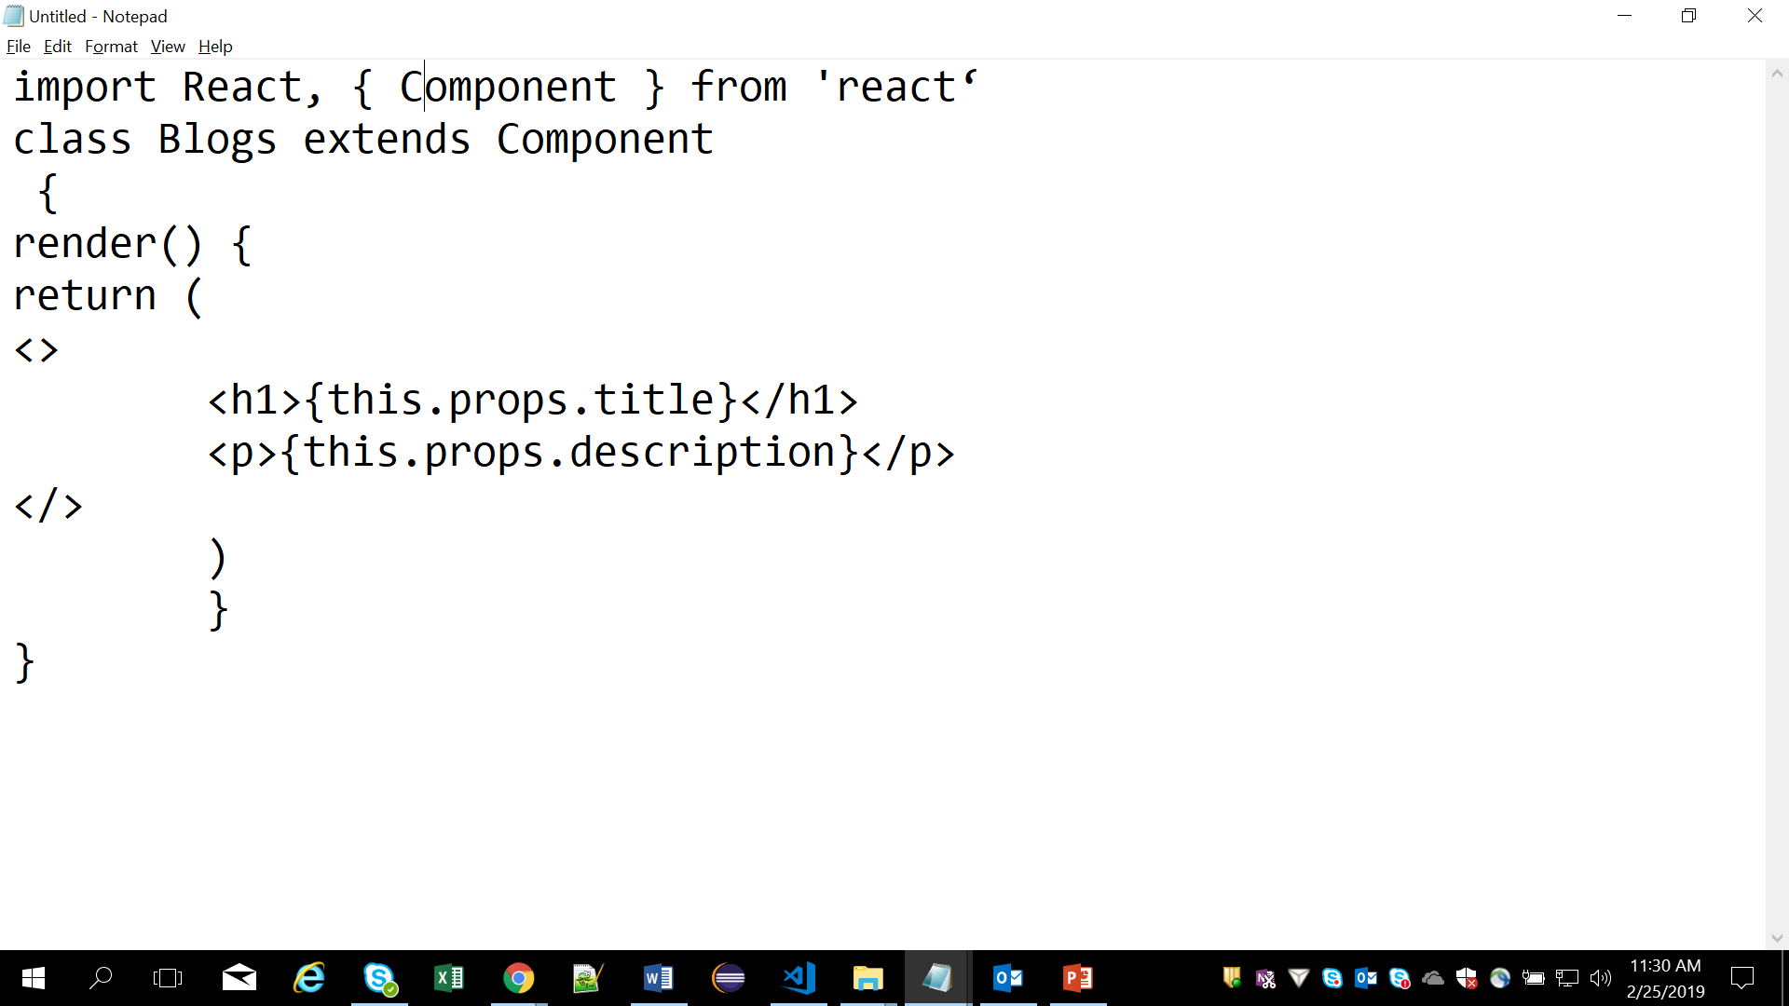
React Fragments
Shorthand syntax + supported attributes : <></> -> A set of empty tags. Be aware though, the Fragment syntax is only supported as of Babel v7.0.0-beta.31.
Notes:
React@16.2 introduces the Fragment component.
we can either import the Fragment component by using belwo statement,
import React, { Component, Fragment } from 'react‘
Or
use it through the React object directly with React.Fragment
Add instructor notes here.

Slide 33
Demo
Fragments
react-fragments-2019
Notes:
Add instructor notes here.

Slide 34
Summary
After this you should be clear with
Updating life cycle hooks
PureComponents
React’s DOM Updating Strategy
Returning adjacent elements
Fragments
Notes:
Add the notes here.
Add instructor notes here.

Slide 35
Review
What are the 3 React component's Life Cycle?
1. Mount,insert,demount,
2. Mounting, merge, unmounting
3. Mounting, merge, demounting
4. Mounting, update, unmounting
In React , Strong Type-checking is Provided by PropTypes? True or False.
_______________ are used to share the code between multiple components.Which is an array of objects.
1. Prop
2. State
3. Mixins
4. components
Notes:
Add instructor notes here.

